Slide 1

Django Presentation: Project MiTunes 2.0
Django is a free and open-source web framework, written in Python.

Slide 2

Student Intro – part I: Who AM I?
Eddrick Butler
Sardis, MS
Graduated from North Panola High School with the Class of 2016
Love using Windows PCs
Spend most of my time trying to find something to work on or new things to get interested in.

Slide 3





Student intro – part II: Interests or Currently interested in
Web Development | Installing, Downloading, and Updating Software | Troubleshooting PC Problems | Playing Music on Keyboard | Writing

Slide 4

STUDENT INFO – PART III: PLANNING FOR THE INCOMING YEAR
Become a successful web developer and computer administrator.
Be the “Provider” for my family to help with bills and more.
Continue to help people troubleshoot and fix problems with their PCs.
Continue My Education to work towards achieving my Bachelors of Science in IT.

Slide 5

Project Info – Part I: Project creation and implementation
COMPLETING THE DJANGO PROJECT WAS CHALLENGING!!
Also, was challenging to the students to see can the assigned task be completed within the due date.
The entire Django Project was an alternative for the Web Dev. Project with extra improvements added. Most of the tools were used again.

Slide 6

Project Info – Part ii: The Requirements
The Knowledge of Django and how it operates.
A functioning, lightweight text editor(i.e. VS Code, Atom, Brackets etc.)
Any command line available.
A Well Thought-Out Plan!!

Slide 7

Project Info – Part III: Milestones To Finishing the Django Project
Once the student is finished and approved, he/she could start creating code for their Django rental store front. Students will be required to finish a project reflection to show how the program will perform and manipulate different tasks.
Prior to moving on, the program needs to be uploaded to Github.com for future references or for bragging rights.

Slide 8

Non-Technical overview: The Purpose & The Real World
The sole purpose was to process the given user information throughout the end of the assignment or program as if they were a real customer willing to purchase something from your store and give the user information back, depending on how they responded.
Majority of the code that I have done or finished for the Django Project will be revisited for future references because you never know what problem you might run into when creating a similar project.

Slide 9
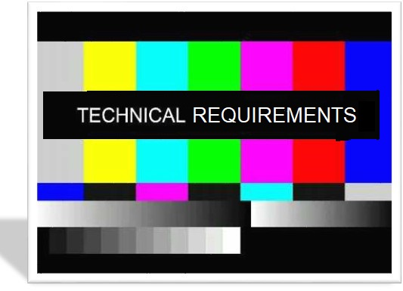
Technological Summary: Technical Requirements – Part I
Text Editors, Visual Studio Code and Sublime Text were used to create the code to make this application function correctly.
GIT was used to update and commit the changes I’ve made.
Programming Languages Python, HTML, CSS, and JS were used to create the information given by the user, display the album elements, and give the webpage a live setting.

Slide 10
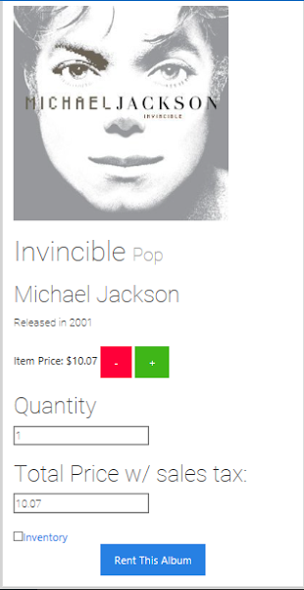
Product walkthrough: Figure 1 – part I
In the image to the left, the user will see what will happen when an album is clicked for renting.
The user will also be given that album’s information.
Also, the user will have the option to change the quantity to how ever many albums they will like to purchase.
After all is done, the user will finally be given a grand total with sales tax, which is $0.07. Not much right?

Slide 11
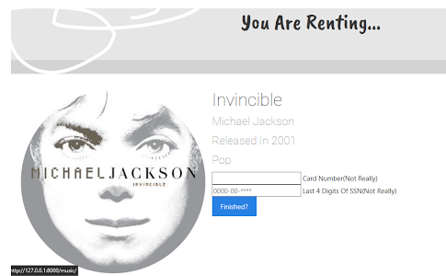
Product Walkthrough: Figure 2 – Part II
In this image, the user will see that they have to provide some information for the server to capture, which includes a pseudo card number and four digit pseudo SSN.
When finished, the user will then click the button “Finished?” to move on.

Slide 12
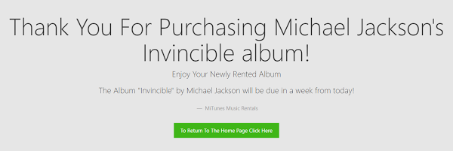
Product Walkthrough: Figure 3 – part III
In the following image after the user has confirmed their purchase, the user will see a confirmation page indicating that they’ve successfully rented the album.
The user can feel free to go back to the homepage to rent another album by clicking the green button at the bottom.

Slide 13
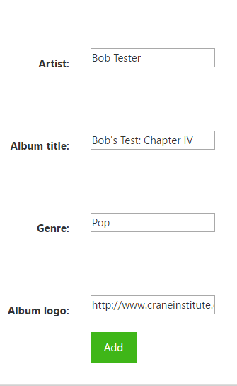
Product Walkthrough: Figure 4 – part IV
In this image, the user will have the option of adding a custom album of their own. The user will provide the artist’s name, the album title and genre, and the album’s art.
Next, the user will then click “Add” to add the album to the homepage’s inventory they’ve just suggested.

Slide 14
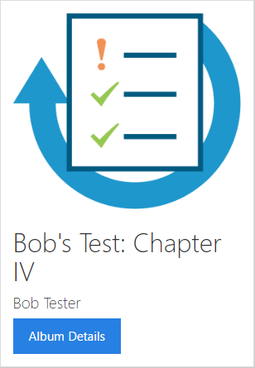
Product Walkthrough: figure 5 – Part V
After the user has finished filling out the required fields, the user will then see the album they’ve made is now in the inventory.
The user can click “Album Details” to view the album’s details, but the release year and price will not be available, since it is not an official album yet.

Slide 15


My Thoughts and Reflections
What was learned? | Version Control | Level of Difficulty | Any Changes? | Advice?
Take it one step at a time DO NOT RUSH! Completing multiple tasks can and will throw you off. | Yes! More than the other projects combined! Commits were made every day. | Very Difficult in SOOO many ways, but once understood, very easy! | The album containers used to be unordered lists, but are now div containers | When trying to find an answer to a difficult question, I recommend using Google or watch YouTube video tutorials on that topic
More At
https://eddrickbutler98.github.io

